Slide 1
Biodiversity
By Kevin Mastascusa and Alexis Tibbs

Slide 2

Introduction
As the human population continues to grow, our demand for resources has significant impacts on the natural world. We are working to shed light on the ways in which human activities have reshaped ecosystems and affected biodiversity over time. This story will explore the specific ways in which human activities have affected biodiversity. Using visualizations, we seek to provide a detailed overview of the state of wildlife today, in addition to how biodiversity has changed in the past.
Notes:
https://ourworldindata.org/biodiversity

Slide 3

Dataset
We have identified the "Biodiversity" dataset from Our World in Data as our dataset for the final project. This dataset provides comprehensive information about the state of biodiversity, including the population trends of vertebrate species from around the world, global land use, deforestation, and other related topics.
Living Planet Index which reports the average change as a single figure.
Earth is home to millions of species. Monitoring how biodiversity is changing is an incredibly difficult task. The Living Planet project provides an essential resource to help us do this: it brings together the data on more than 30,000 animal populations across the world to understand how they are changing.

Slide 4
Motivating Questions
Our project aimed to explore the impact of human activities on biodiversity, deforestation, land use and agriculture, and greenhouse gas emissions. Specifically, we wanted to answer the following questions:
How has human activity impacted global biodiversity?
What are the main drivers of deforestation and land use change, and what regions are most affected?
What are the environmental consequences of agricultural production?
What are the main sources of greenhouse gas emissions, and how have they changed over time?

Slide 5
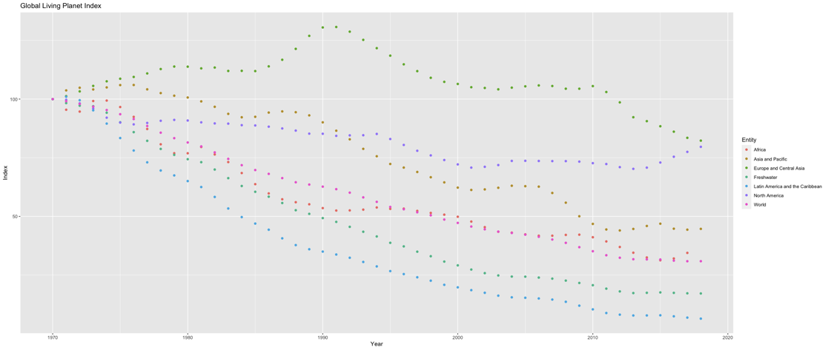
Scatter plot of the global Living Planet Index over time:
This plot shows the trend in the Living Planet Index over time, which is a measure of the state of global biodiversity.
The scatter plot shows the overall trend in the index and variation by Entity (e.g., country or region).
The plot indicates that the index has been declining over time, which is a concerning trend for global biodiversity.

Slide 6
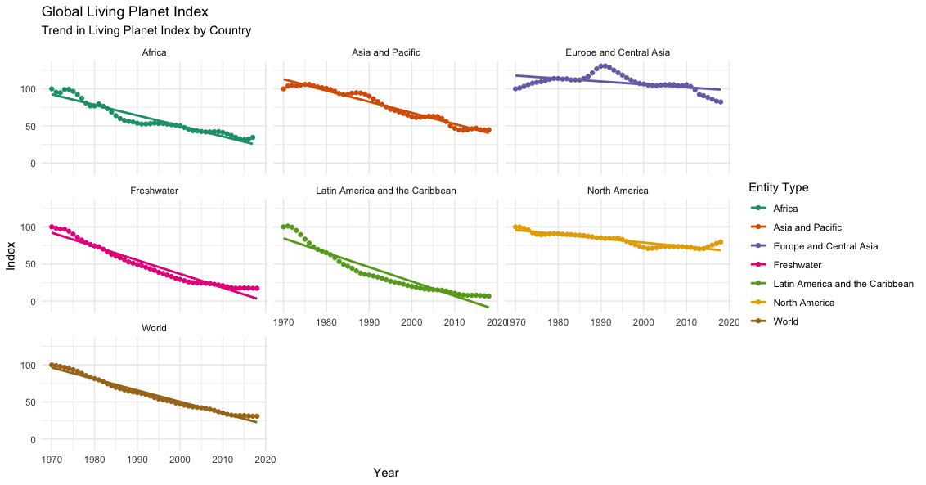
2. Trend in Living Planet Index
Trend in the global Living Planet Index over time by country:
This plot shows the trend in the Living Planet Index over time for different countries or regions. The plot uses a linear regression line to show the overall trend and is faceted by Entity to show variation by country or region.
The plot indicates that some countries or regions have seen a decline in the index over time while others have remained relatively stable.

Slide 7
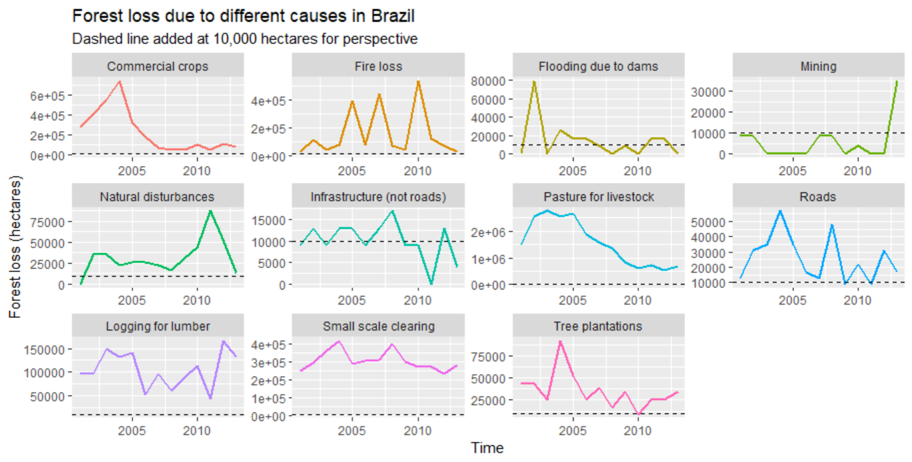
3. Small Multiples
The first visualization shows the forest loss due to different causes in Brazil over time, with each cause shown in a separate panel.
The x-axis represents time, and the y-axis represents forest loss in hectares. The causes of forest loss are represented by different colored lines, with a dashed line added at 10,000 hectares for perspective. The plot provides an overview of the various causes of forest loss and how they have changed over time in Brazil.

Slide 8
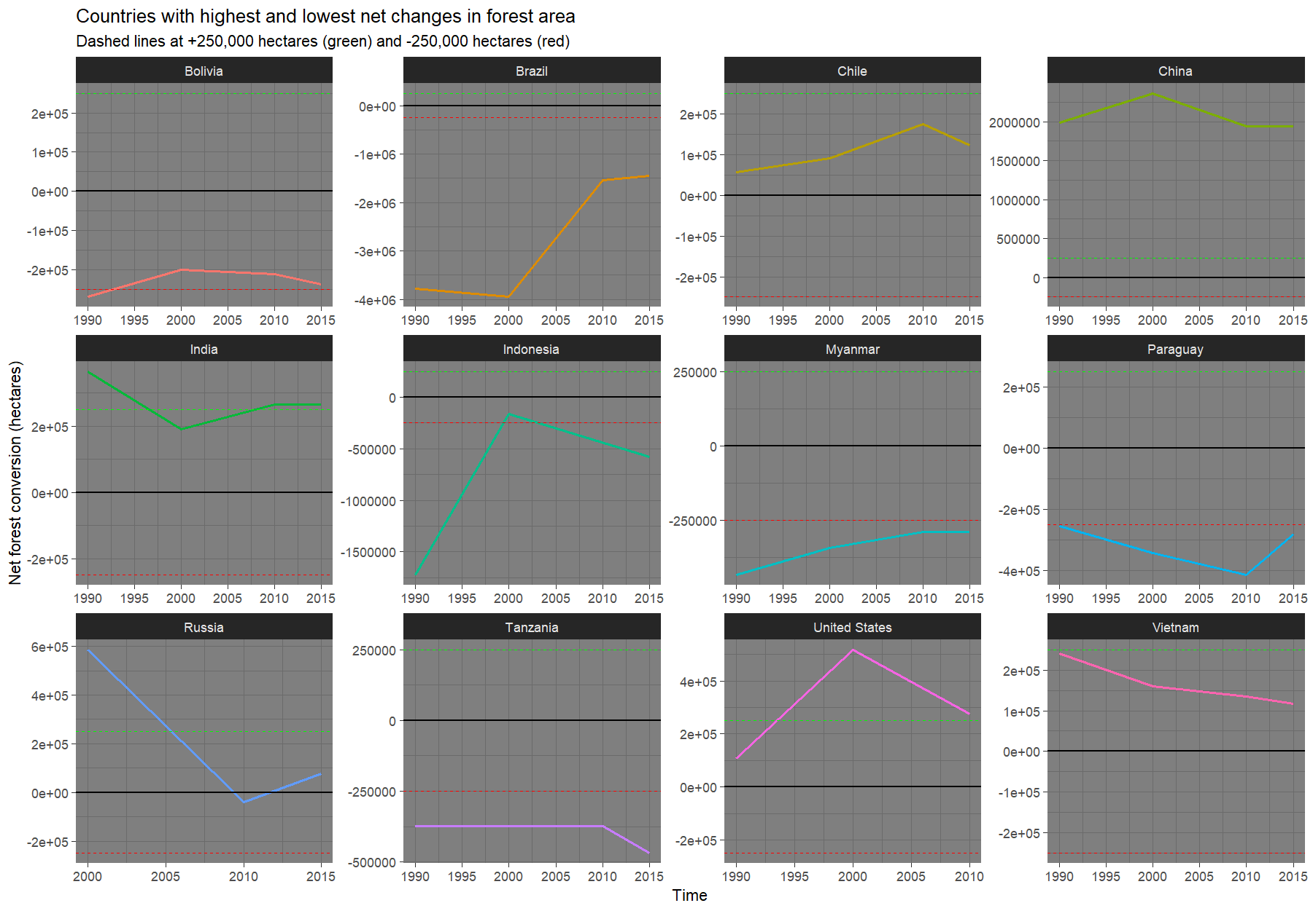
4. Countries with highest and lowest net changes in forest area
The second visualization shows the net change in forest area across different countries over time. The x-axis represents time, and the y-axis represents net forest conversion in hectares.
The various countries are represented by other colored lines, with dashed stripes at +250,000 hectares (green) and -250,000 hectares (red). The plot provides an overview of the countries with the most significant and lowest net changes in forest area and how they have changed over time.
The second plot, which shows the net change in forest area for a dozen countries, is an example of small multiples. This is because it uses facets to create a grid of individual plots, each showing the net change in forest area for a single country.
Using facets, the plot can display multiple views of the same data type in a compact and easily digestible format. The use of color to distinguish between the different countries also helps to make the plot more visually appealing and easier to interpret.

Slide 9
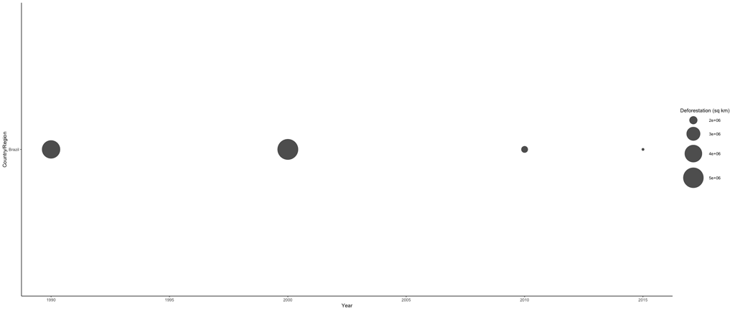
5. Bubble chart showing deforestation data for Brazil only
Using a bubble chart, this plot shows the amount of deforestation that occurred in Brazil over time.
The bubble size corresponds to the amount of deforestation that occurs each year.
The plot indicates that deforestation in Brazil has been declining over time, which is a positive trend for biodiversity.
The plot also shows that deforestation remains a significant issue in Brazil, highlighting the need for continued conservation efforts.

Slide 10
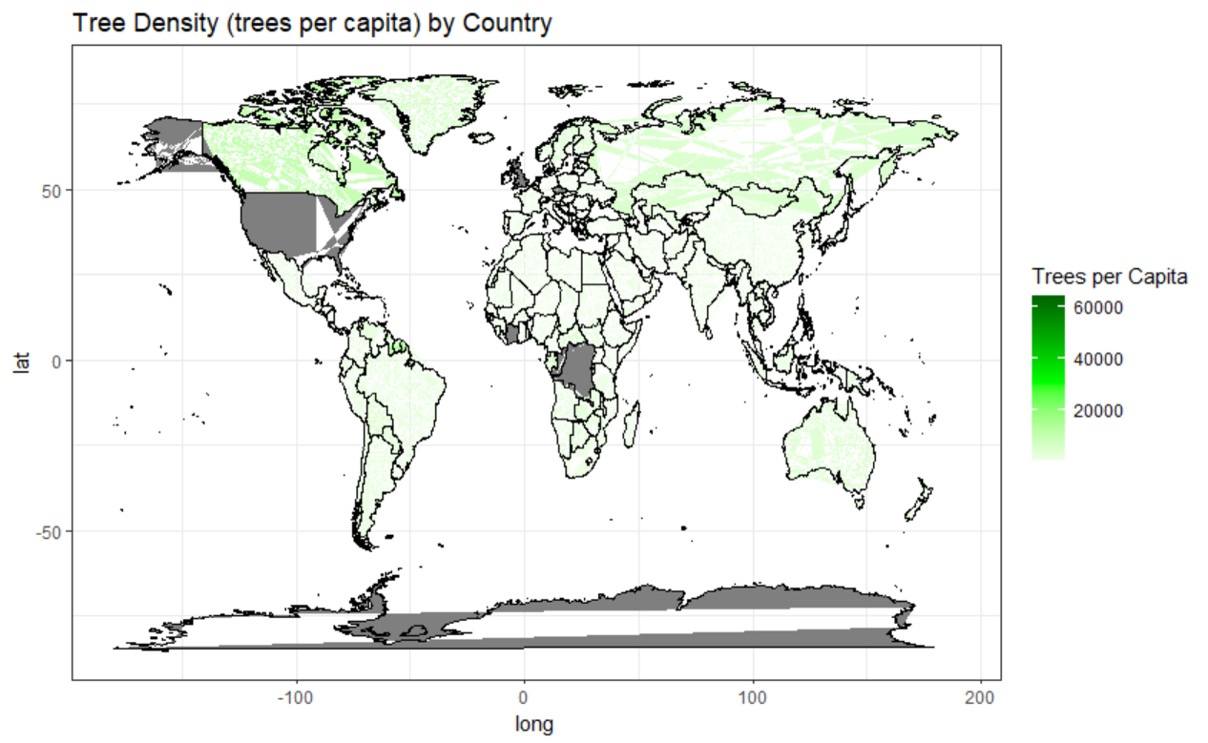
6. World map showing the distribution of deforestation:
This plot shows a world map colored by the amount of deforestation in different regions.
The plot indicates that deforestation is a significant issue in many parts of the world, highlighting the need for global conservation efforts.

Slide 11
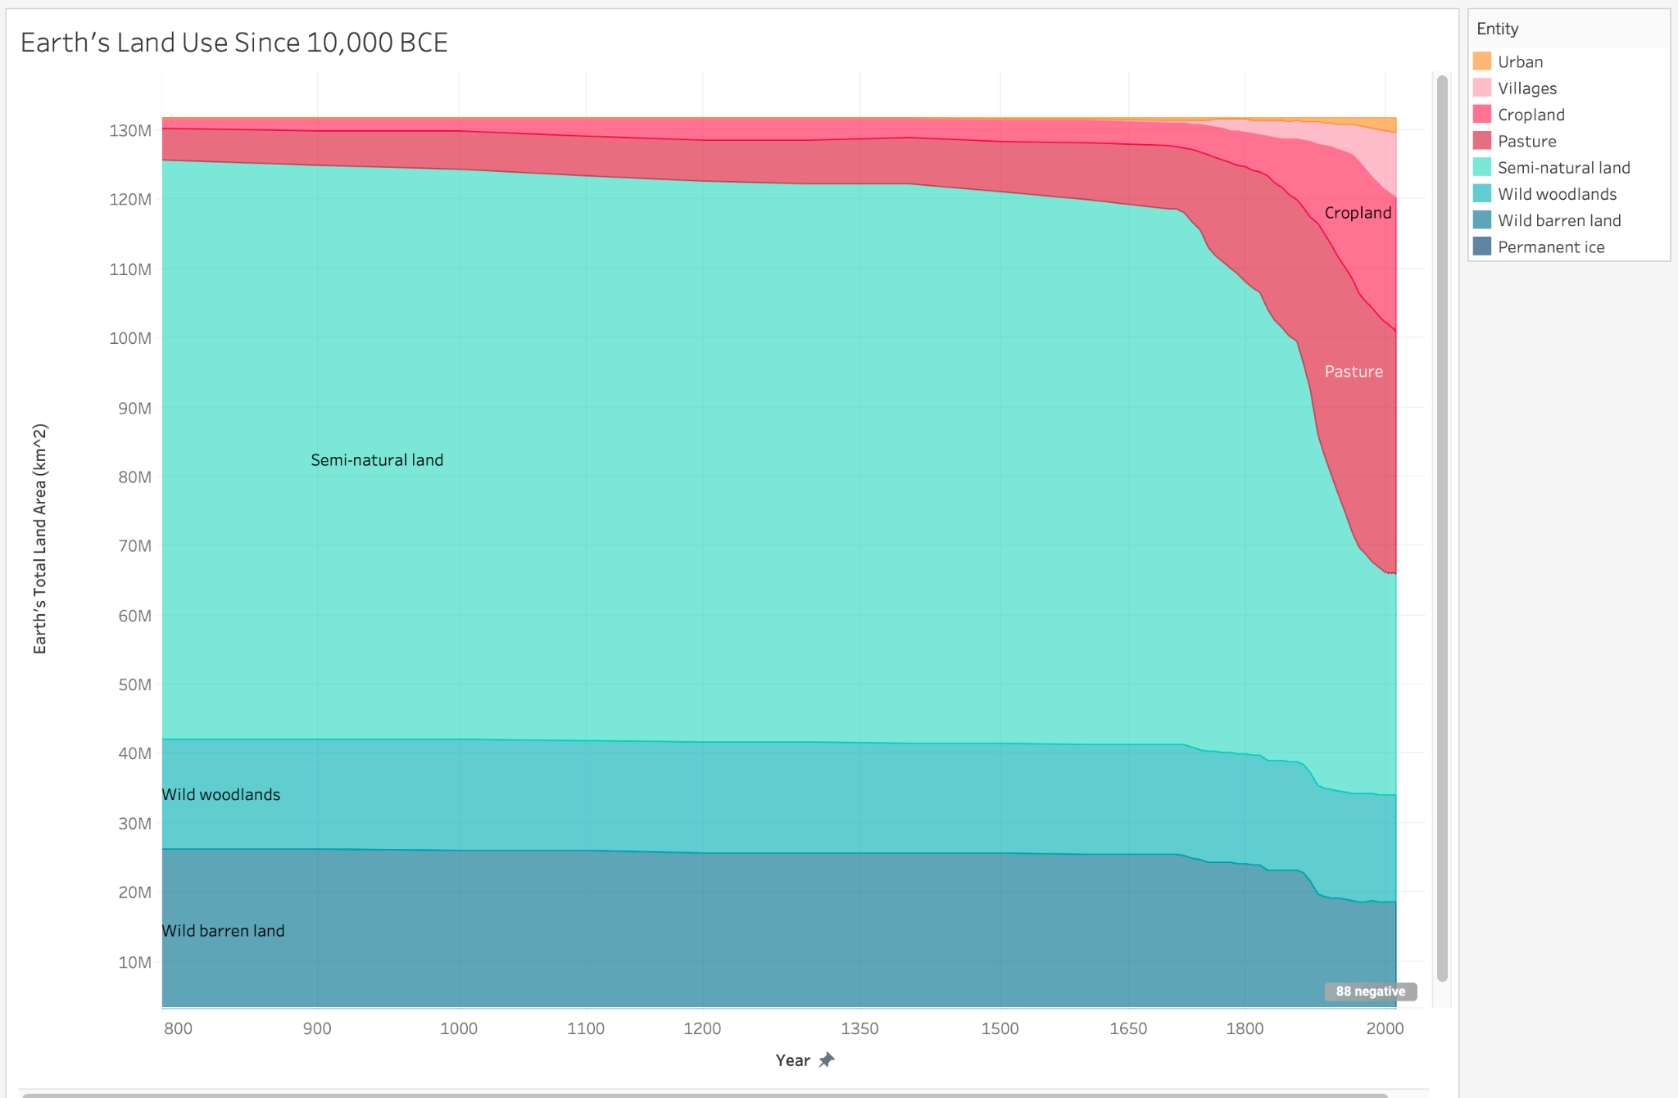
7. Area chart describing how land use has changed over time:
This area chart describe how decreases in biodiversity via deforestation has occurred based on how land has been used over time:
The chart indicates that land stability was shaken up around the early 1700s due to a large increase in agriculture.
Around 10% of the world’s land mass was consumed by human civilization before the 1700s. This number is now around 50%
The most disturbed land type has been semi natural grassland.
This shows that grassland ecosystems have been largely replaced by engineered environments for cattle and crops.

Slide 12
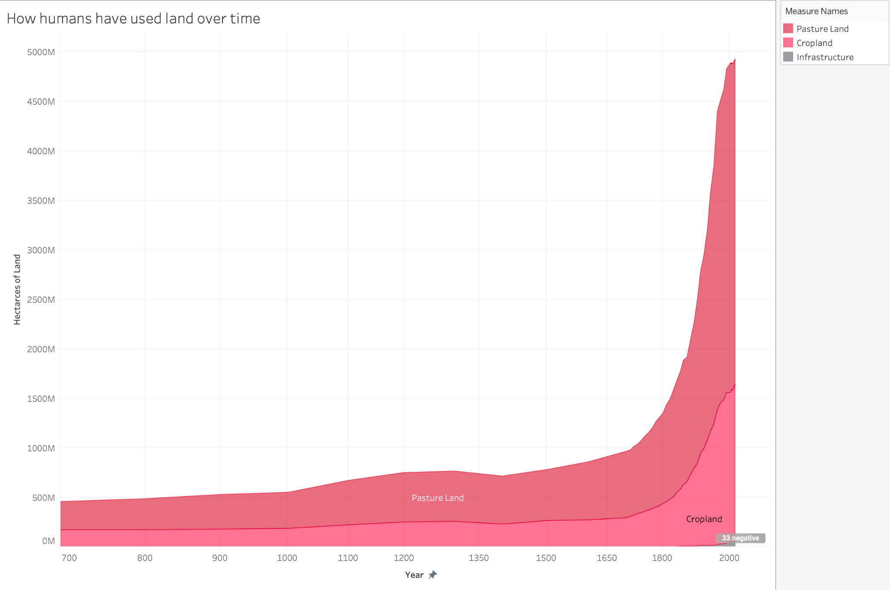
8. Area chart of agricultural distribution and infrastructure:
Human agriculture is mainly divided into pasture land and cropland.
Pasture land alone sieged to around 3 billion hectares in 2016. That is 26% of earth’s land.
Cropland rose to around 1.5 billion hectares, or 14% of earth’s land.
40% of earth’s land is used just for food factories.
Note how insignificantly small infrastructure land is (>1%)

Slide 13
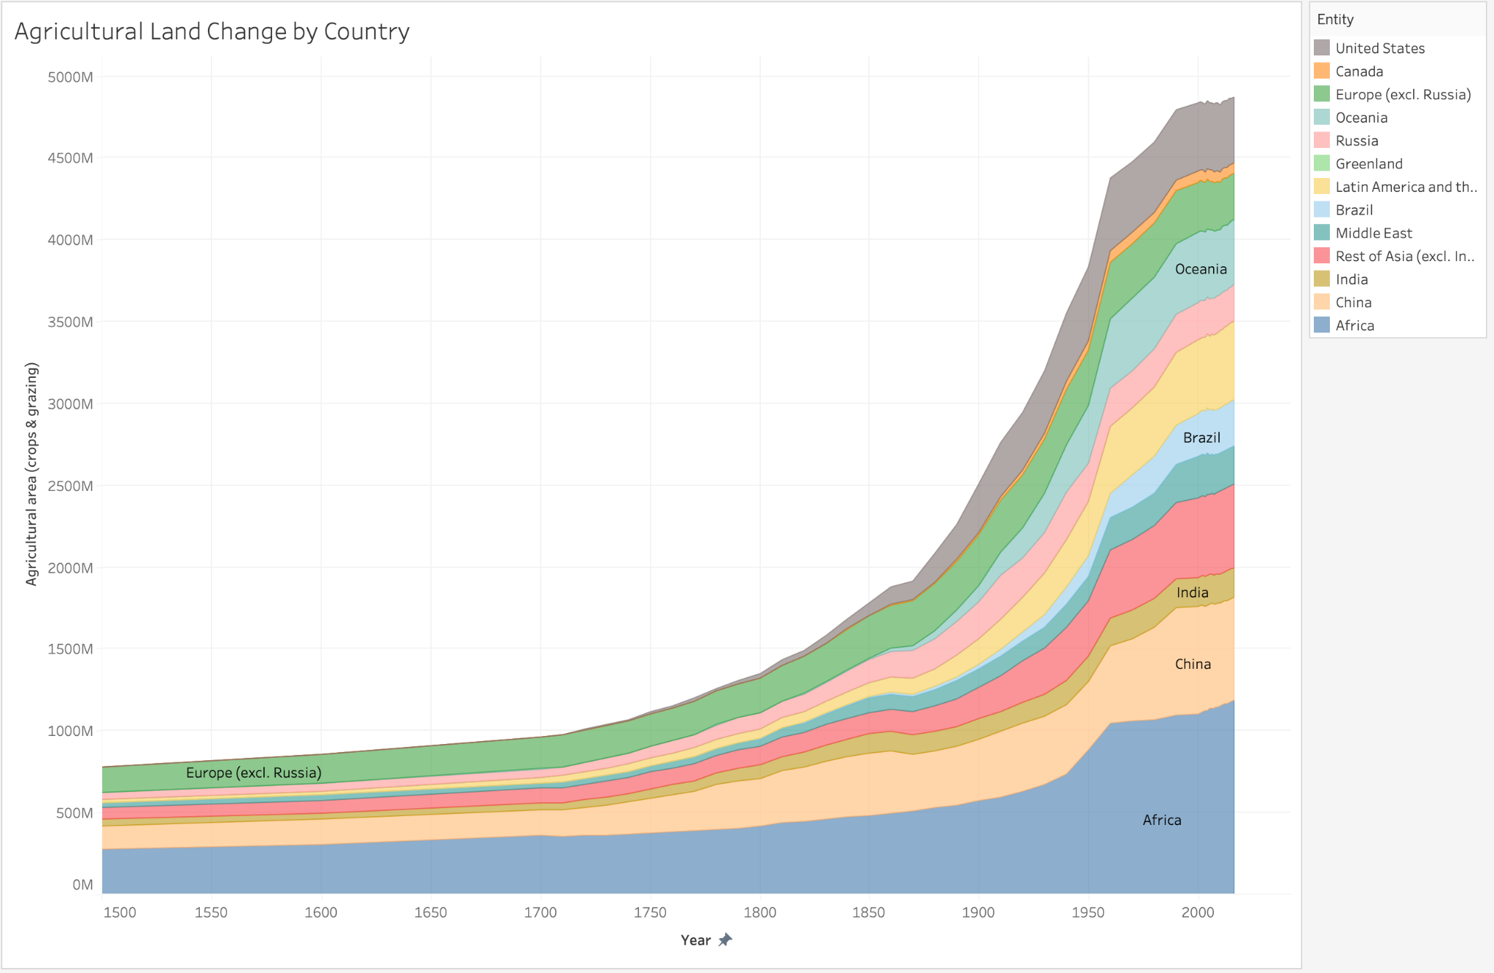
9.Area chart of agricultural land change by country and continent:
This area chart reveals how much different countries take fault for the decrease in biodiversity due to agriculture increase.
The largest contributor is Africa at 1 billion hectares of agricultural land.
China follows 2nd with 600 million hectares.
The remaining countries are stacked by similar region such as Brazil and Latin America totaling over 750 million hectares together.

Slide 14
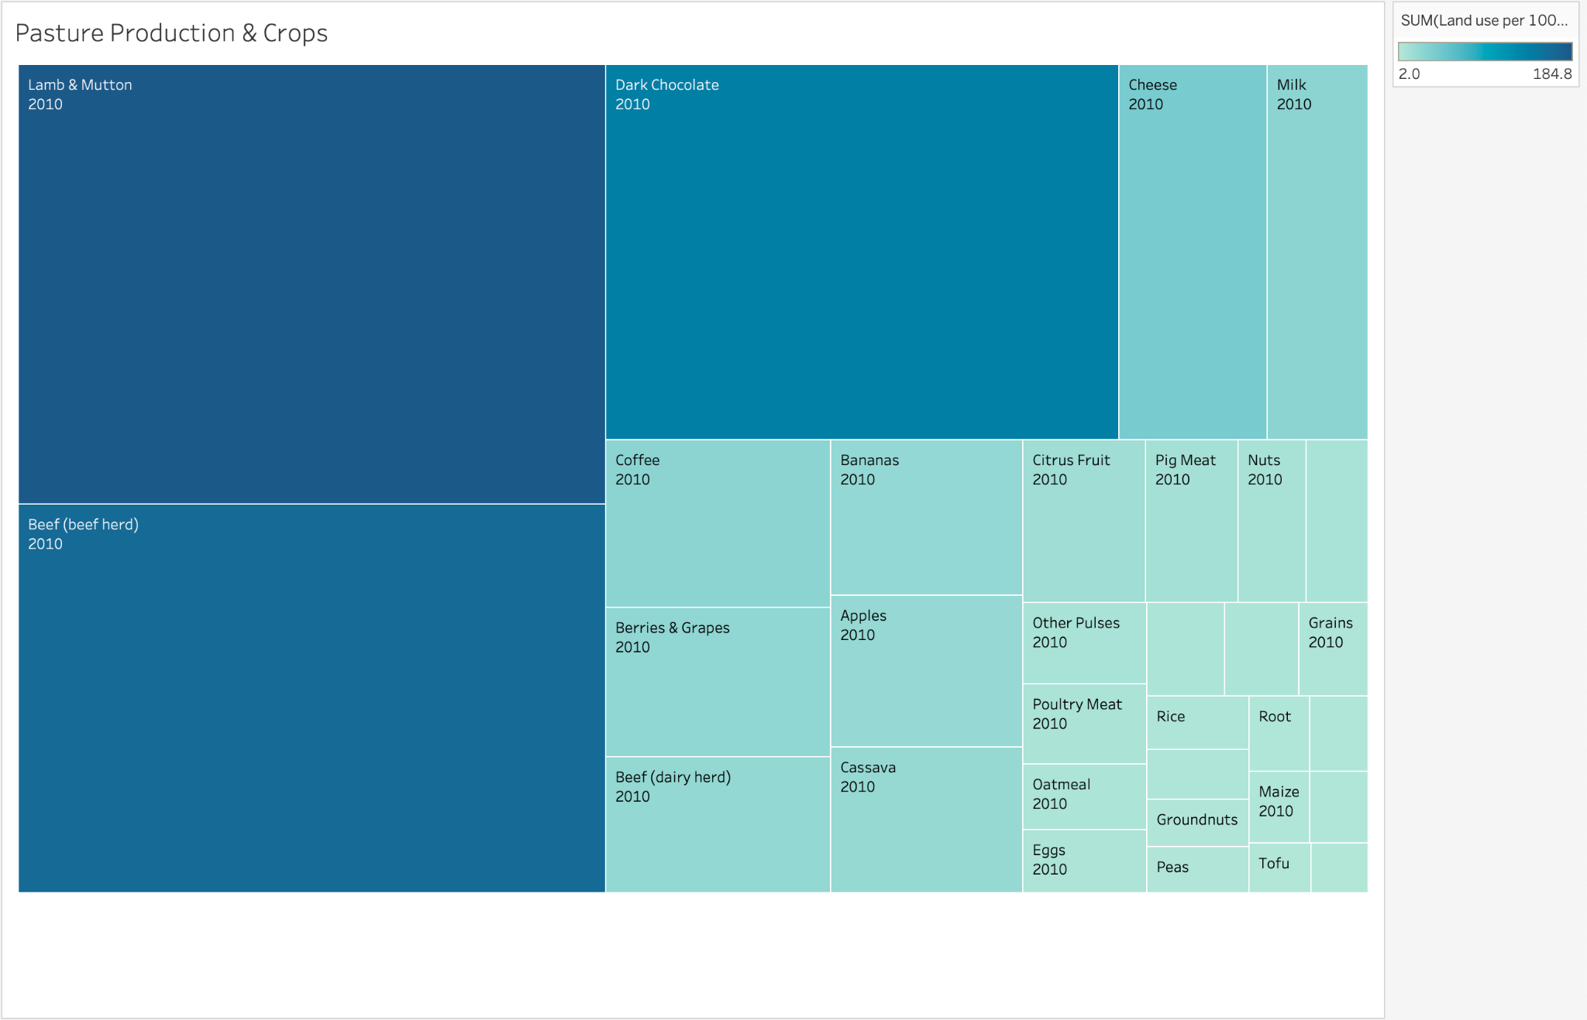
10. Tree map of the area needed to produce animal products and crops for 2010:
The tree map reveals what agricultural products the world was focused on in 2010.
What stands out immediately is the land needed for meat products, most noticeably lamb leading with 184.8 meters squared per 100g of protein, followed by beef at 163.6 meters squared.
Dark chocolate is in third at 137.9 meters squared, but it is important to note that other animal products like cheese and milk also ranked high on the list.
Other animal products like poultry and pig meat take up significantly less space indicating that larger livestock may shift the ecosystem the most.

Slide 15
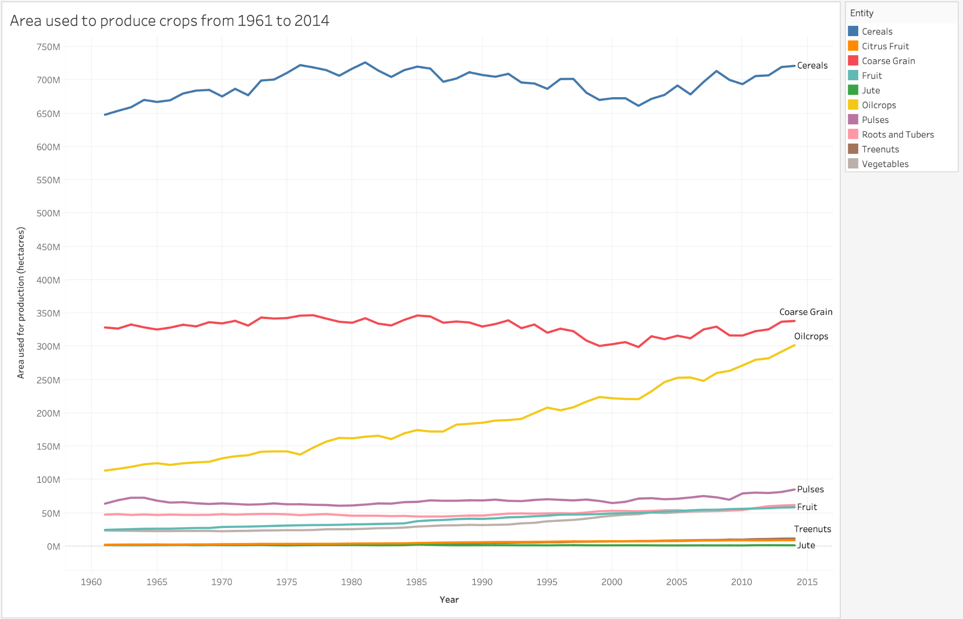
11. Line chart of area used to produce crops from 1961 until 2014:
This line chart reveals how crops have changed over time.
Cereal production which rose from around 650 million hectares to 720 million hectares, coarse grain which has remained stable around over 300 million hectares, and oil crops which had a significant spike from around 110 million hectares to 300 million hectares stand out the most.
The rest of the crops remain relatively low.

Slide 16
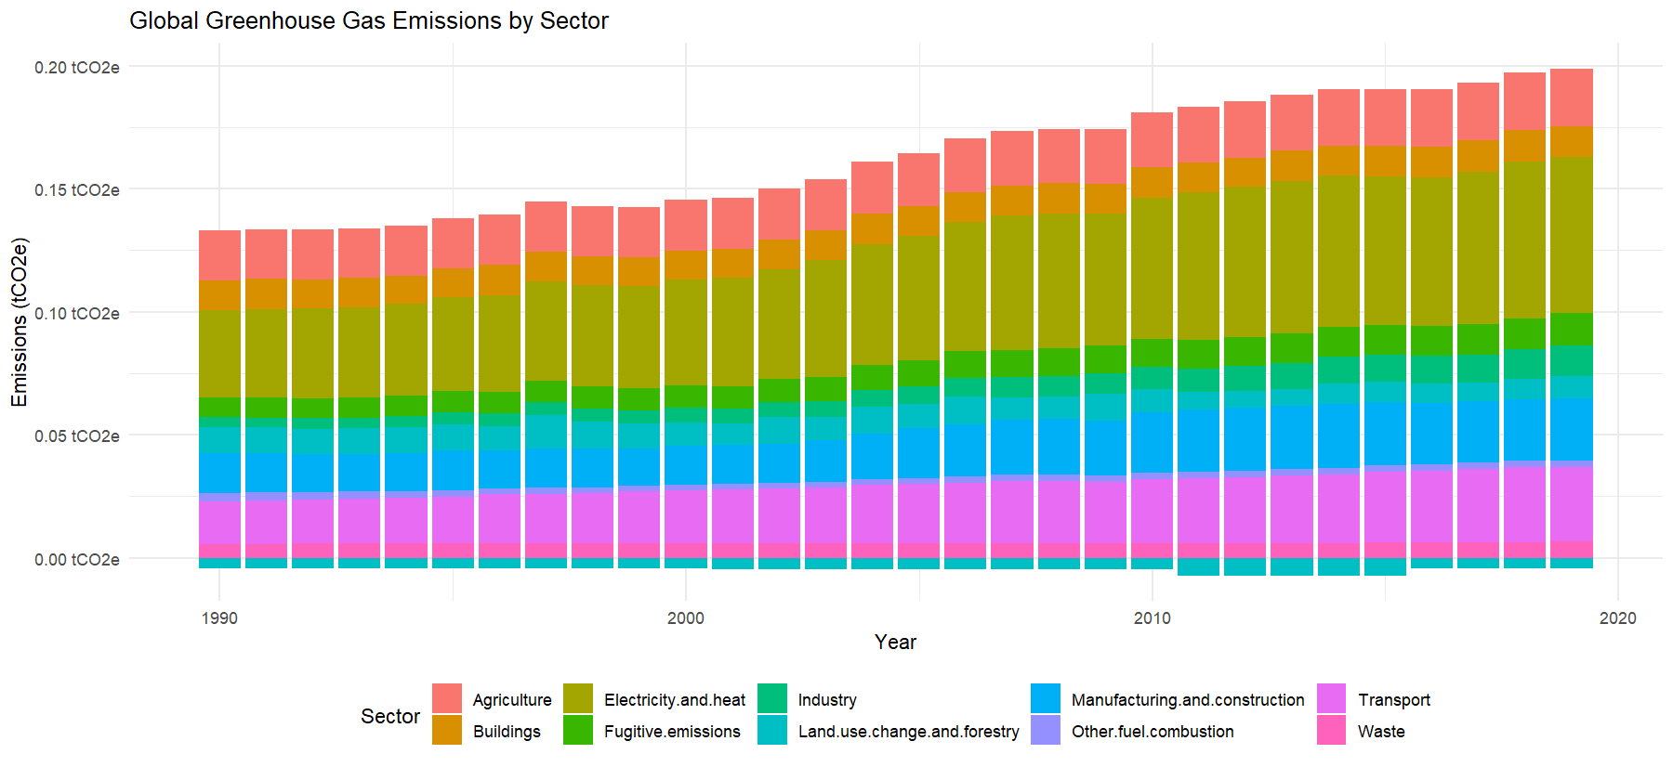
12. Stacked bar chart to visualize global greenhouse gas emissions by sector
The stacked bar chart shows the contribution of each sector to global greenhouse gas emissions over time.
The chart highlights the dominant sectors responsible for greenhouse gas emissions: energy, industrial processes, agriculture, and transportation.
The chart also shows the changing patterns of emissions over time, with energy and transportation sectors exhibiting steady growth in emissions while other sectors show fluctuating patterns.
The use of a stacked bar chart emphasizes the total amount of emissions and the relative contribution of each sector to the total while allowing for easy comparison between sectors.

Slide 17
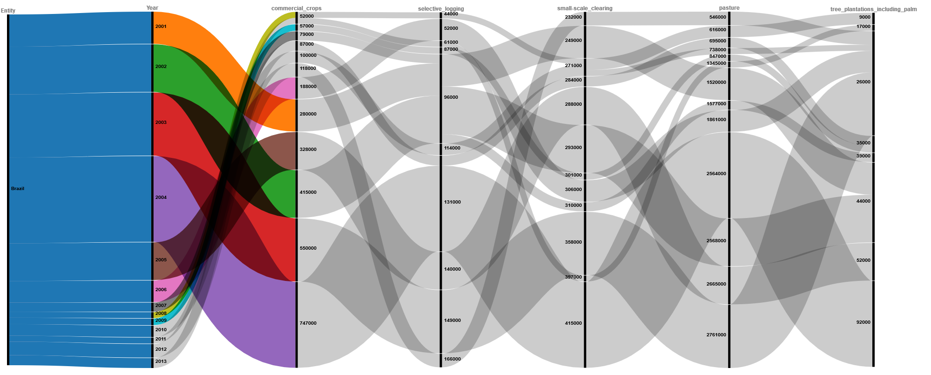
13. Network Diagram
Alluvial diagram provides a clear and concise visualization of the main drivers of deforestation in Brazil, highlighting the relative importance of each driver and their interconnections.
The size of each ribbon corresponds to the sum of the forest loss caused by commercial crop production for each year.
Brazil is home to the Amazon rainforest, which is an extremely biodiverse area. The main message of this visualization is to highlight the impact of agriculture and human activity on one of the most biodiverse areas in the world, and the need for further conservation efforts.

Slide 18
Incorporating Feedback
Although you did a great job in creating the graphs in R, I have to say that the Bar chart of deforestation, plot of deforestation data over time, and the bar chart showing total embodied emissions by country were not clear.
The x-axis shows all the labels of the countries making it hard for the reader to find a single point in the graph. How long would it take for the readers to pick the value for “United States” in the above graph? They would have to search every single label, assuming that it is not overlapped with some other label, and this process would take a lot of time.
I would recommend you either group the countries by their continents or just showing the top 20 important countries that you think needs highlighting.

Slide 19
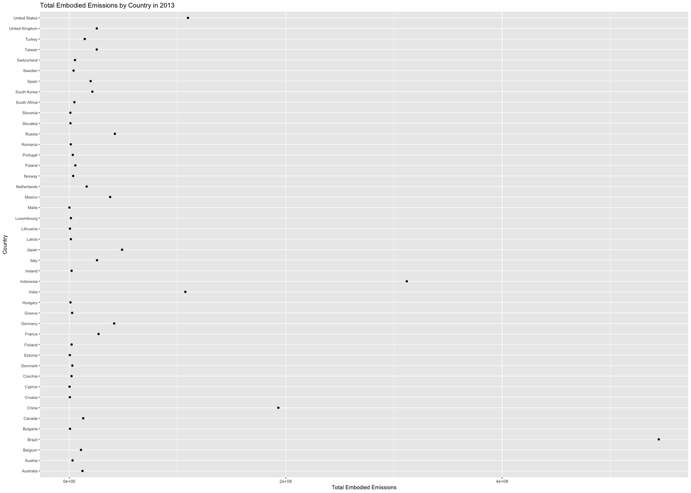
Dot Plot
The dot plot was cluttered and difficult to read.
There were too many points in the plot, making it hard to discern any patterns or trends.

Slide 20
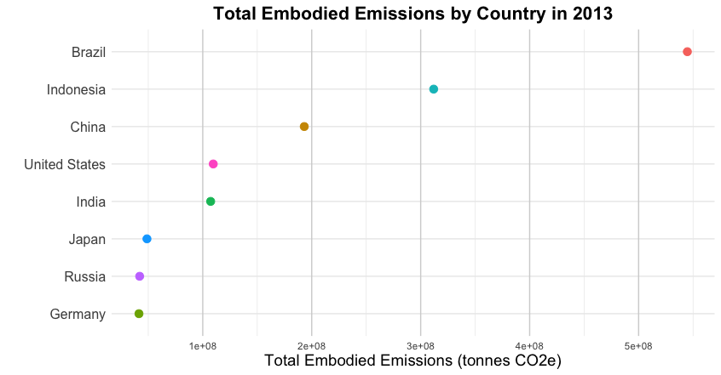
Improved Dot Plot
Reordered the countries by their total embodied emissions: This improvement makes it easier to compare the countries and identify which ones have the highest embodied emissions.
Subsetting the data to show only the top 8 countries: By showing only the top 8 countries with the highest embodied emissions, the dot plot becomes less cluttered and easier to interpret.
Using a custom color palette makes the dot plot more visually appealing and easier to read.

Slide 21
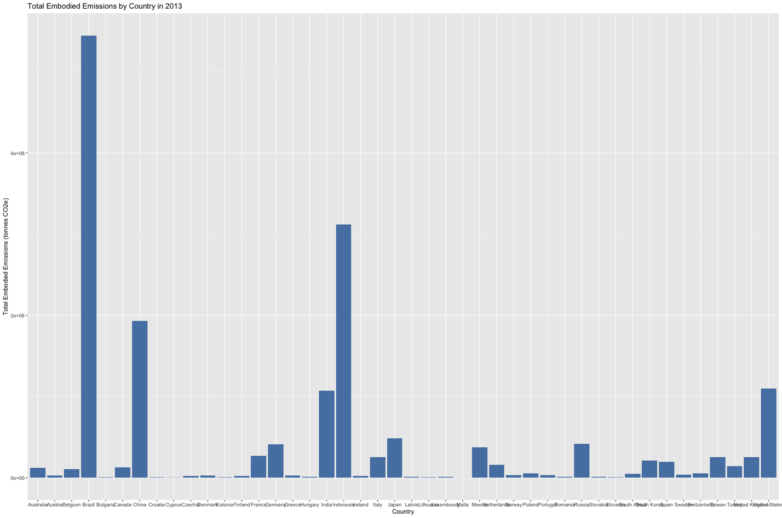
Bar chart showing total embodied emissions by country.
The x-axis shows all the labels of the countries making it hard for the reader to find a single point in the graph. However, the dot plot we made conveys the same information more effectively.
How long would it take for the readers to pick the value for “United States” in the above graph? They would have to search every single label, assuming that it is not overlapped with some other label, and this process would take a lot of time.

Slide 22
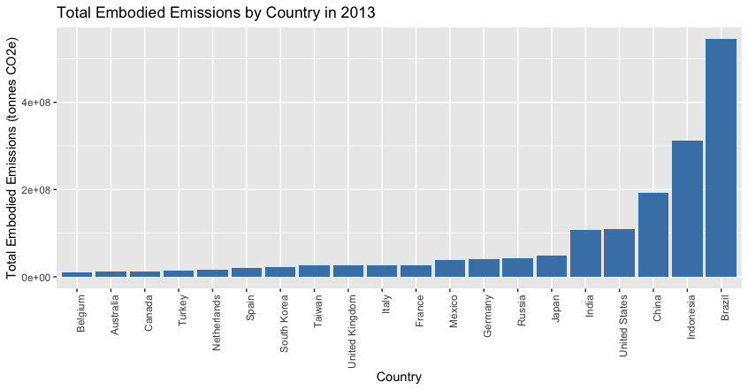
Improved Bar Chart
Subsets the data to only include observations from the year 2010 using indexing.
It aggregates the data by country using the aggregate() function, and selects the top 20 countries with the highest deforestation using head() and order().
The x-axis labels are rotated for better visibility using theme()

Slide 23
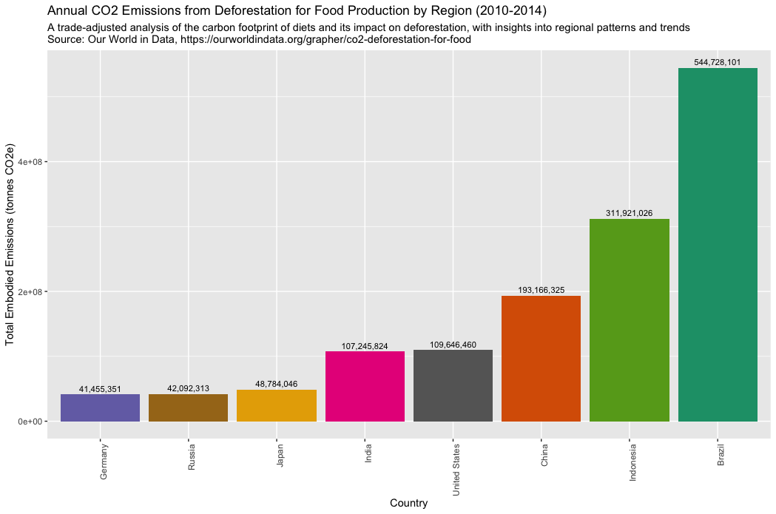
Further improvements
It's important to always double-check the data sources and documentation to make sure you're using the correct information.
In this case, it seems that the data was actually based on the annual average over the period from 2010 to 2014, not just 2013.
The confusion may have been caused by the "Year" column in the dataset, which led us to believe that the data was specifically for 2013.
Changed color palette to Dark2 using scale_fill_brewer(palette = "Dark2")
Subset data for top 8 countries with highest embodied emissions using head() function
Changed the plot title to "Annual CO2 Emissions from Deforestation for Food Production by Region (2010-2014)"
Added a subtitle explaining the data source and methodology used

Slide 24
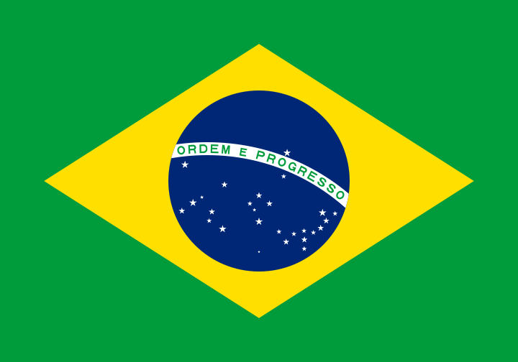
Brazil, Biodiversity, & the Amazon Rainforest
Improvements to data visualization can often lead to new insights and a better understanding of the data.
Brazil is a country with particularly high levels of CO2 emissions resulting from deforestation for food production compared to other countries in the dataset.
This could be due to a variety of factors, such as the extent of deforestation for agricultural purposes, the types of crops grown, methods of land management, etc.
Brazil is home to the largest number of plant and animal species in the world, making it a crucial area for global biodiversity conservation. The Amazon rainforest, which spans across nine countries including Brazil, is one of the most biodiverse areas on the planet and contains a vast array of plant and animal species that are not found anywhere else in the world.
Brazil is also home to a number of endangered species. Conservation efforts in Brazil are critical to protecting these species and maintaining global biodiversity.

Slide 25
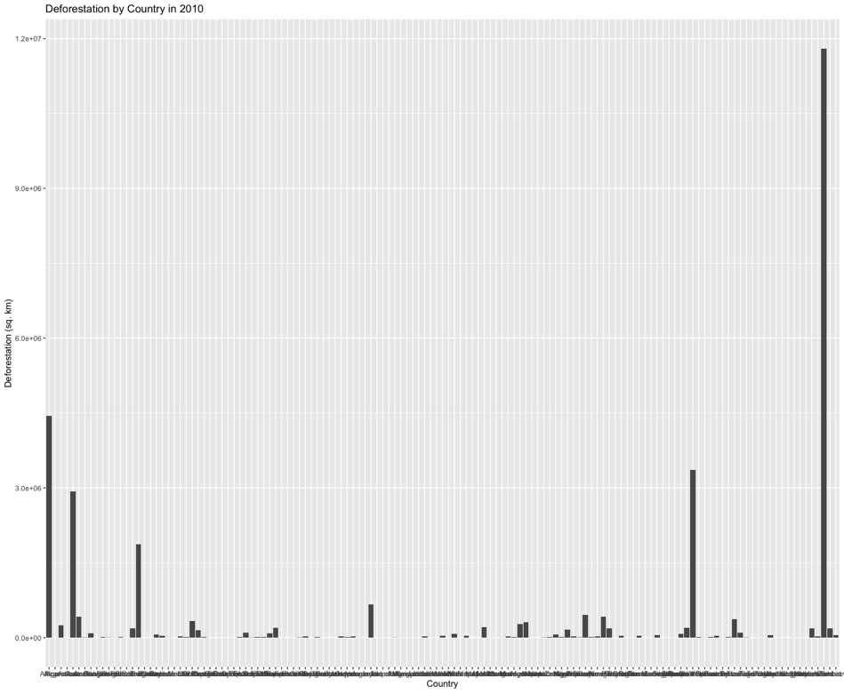
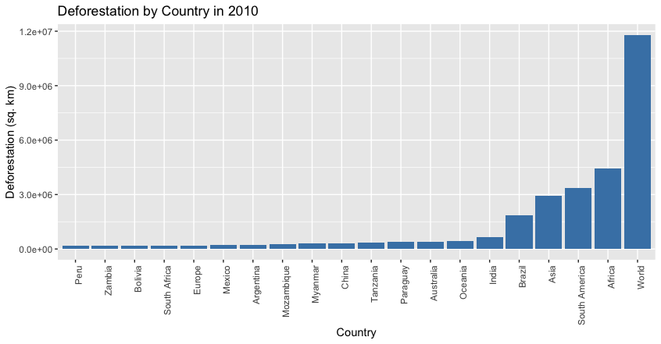
Bar chart of deforestation
I would recommend you either group the countries by their continents or just showing the top 20 important countries that you think needs highlighting. Other than that, great work!
Notes:
Bar chart of deforestation by country in 2010, showing top 20 countries only

Slide 26
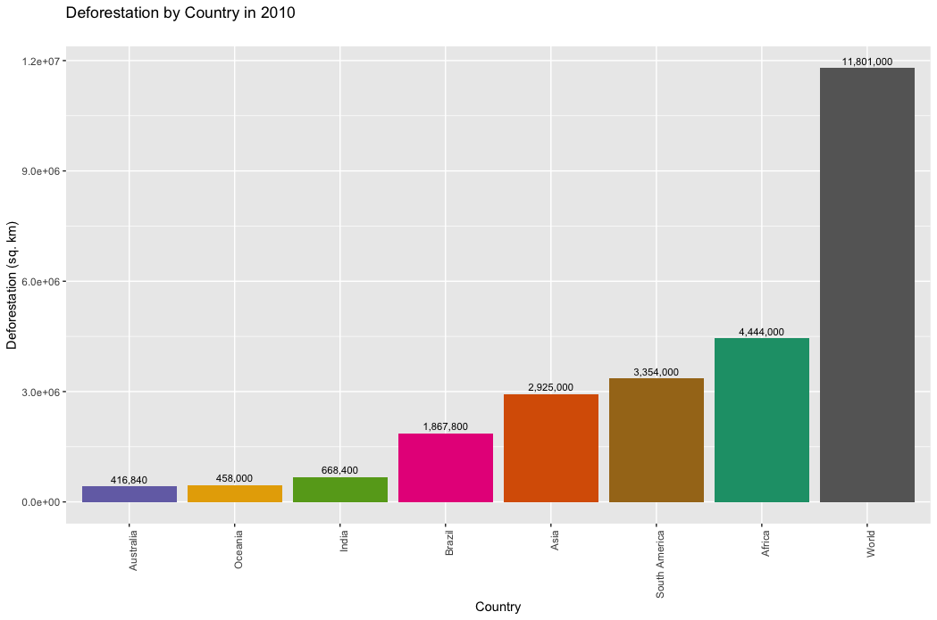
Bar chart of deforestation
Subsetting data to only show the top 8 countries by deforestation in 2010 for better clarity and readability.
Sorting the data by deforestation in descending order to highlight the countries with the highest levels of deforestation.
Using a different color palette to enhance the visual appeal of the chart while maintaining clarity and readability.
The data labels have been added to the top of each bar to show the exact value of deforestation for each country.

Slide 27
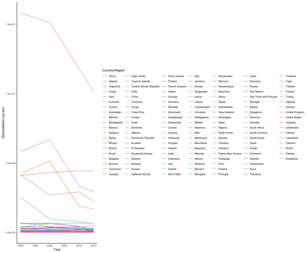
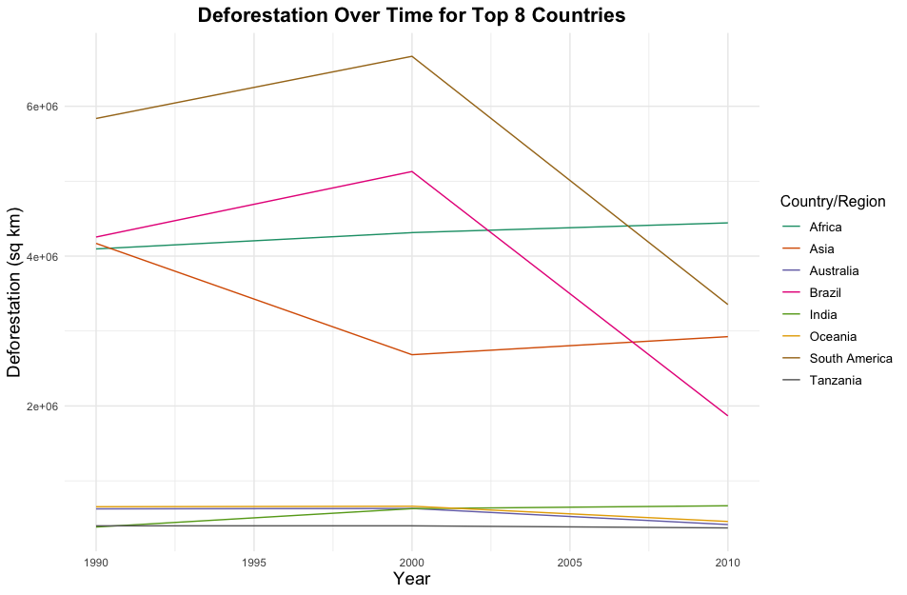
Plot of deforestation data over time
Subsetting the data to show only the top 8 countries/regions with highest deforestation to improve clarity. Dataset is further subsetted to only include data from the years 1990 to 2010.
The entities World and Indonesia were removed using filter().
By excluding these entities, we can focus on the deforestation rates of the top 8 countries with the highest deforestation rates, which is the main objective of this analysis.
Additionally, Indonesia is excluded due to incomplete data, which could skew the results and affect the overall analysis.
Adding a title and axis labels to improve interpretability.

Slide 28
Lessons Learned
Cluttered and unclear plots can obscure the information and make it difficult for the reader to understand.
Adding informative titles and labels to your plots is important for helping the reader understand what the plot is showing.
Grouping and summarizing data can simplify the plot and make it easier to understand.
Adjusting the formatting and theme of the plot can greatly improve its readability and effectiveness.

Slide 29
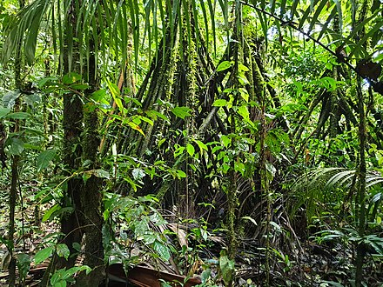
Conclusion
These visualizations highlight the importance of conservation efforts to protect global biodiversity and address deforestation and embodied emissions. They also highlight the need for targeted conservation efforts in regions where these issues are most pressing.

Slide 30
The End

Slide 31
References
https://ourworldindata.org/living-planet-index-understanding
https://ourworldindata.org/biodiversity

